Slide 1
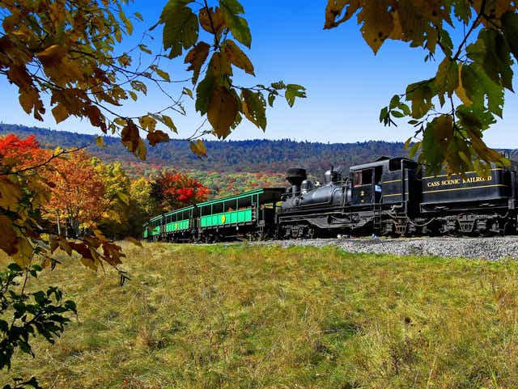
TRAIN TICKET BOOKING SYSTEM

Slide 2
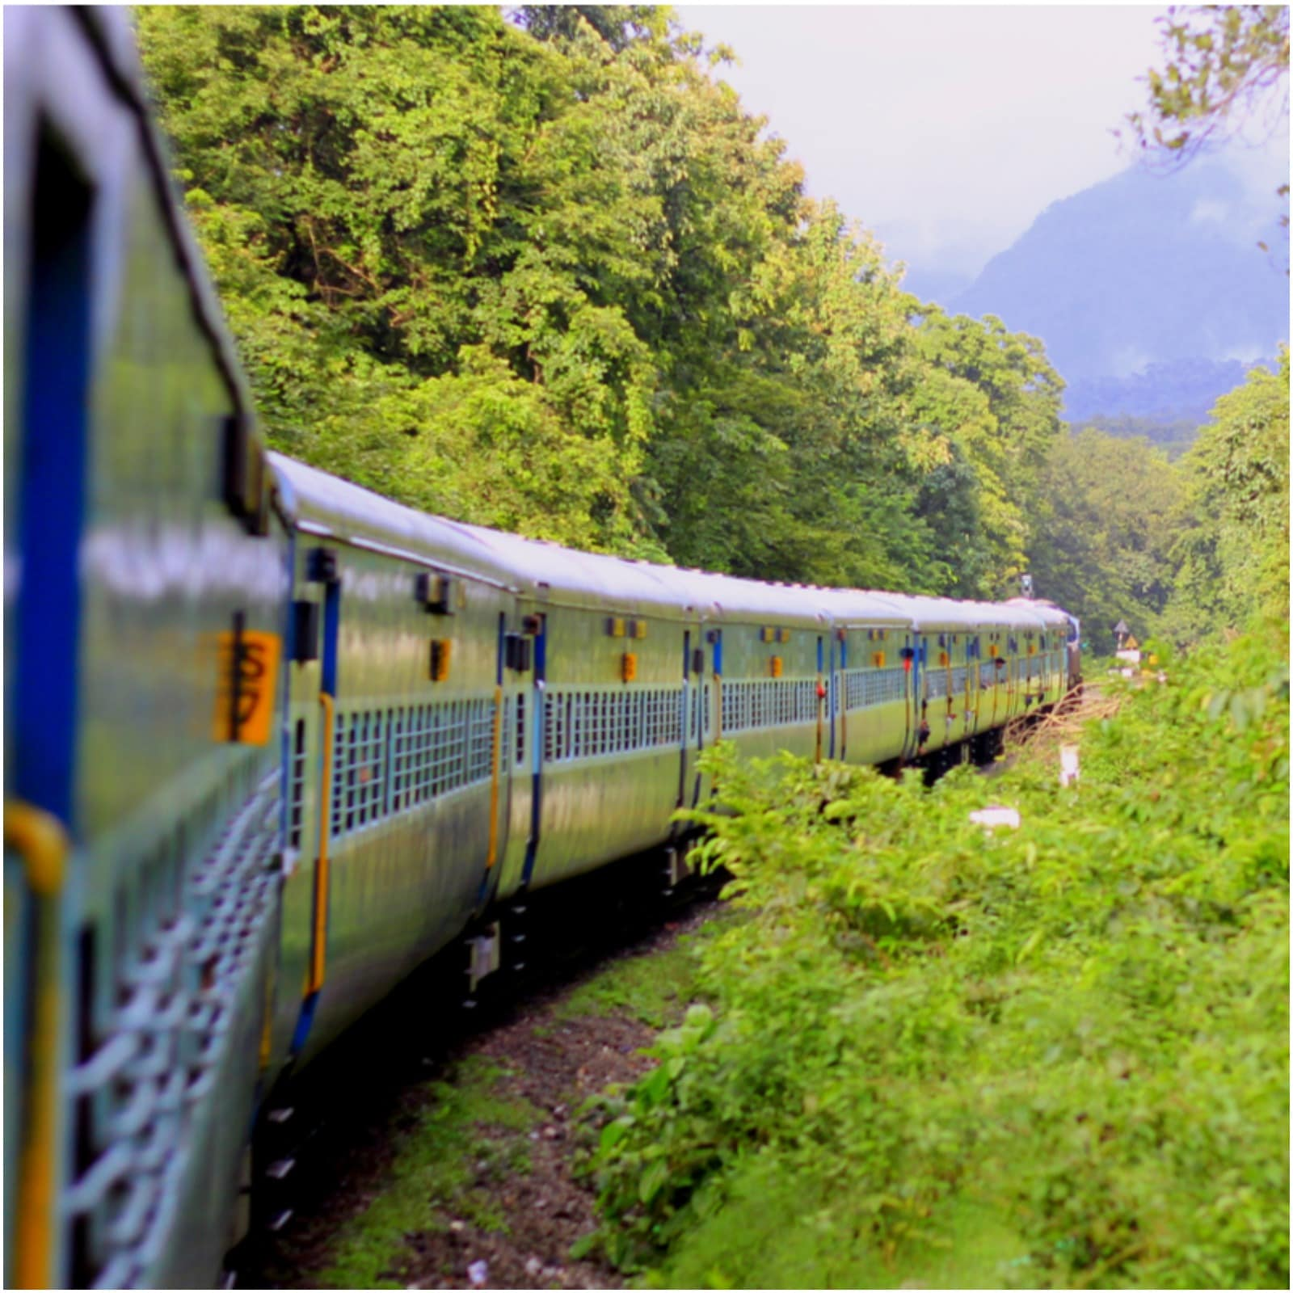
CONTENTS
Team Details
Tools and technologies
Screenshots

Slide 3

BATCH-95
CHETHAN KUMAR
DIVYA CHANDREGOWDA
KUMARA UDDANDAM
MANJUNATH BHASKAR
NISHMITHA DASARAJU
PALLAVI SURESH

Slide 4
Web UI
01
HOME PAGE
02
USER LOGIN
03
SIGN UP AND LOGIN PAGE
04
AVALIABLE TRAINS PAGE
05
TICKET BOOKING PAGE
06
CONFIRM TICKET
07
ADMIN LOGIN
08
ADD TRAIN
09
LOGOUT

Slide 5
Tools and Technologies
TOOLS
My SQL workbench
JDK
Eclipse
Apache server-Tomcat-9.0
TECHNOLOGIES
MY SQL
JAVA
MAVEN FRAMEWORK
JDBC FRAMEWORK
SPRING BOOT
HTML
CSS
JAVA SCRIPT

Slide 6
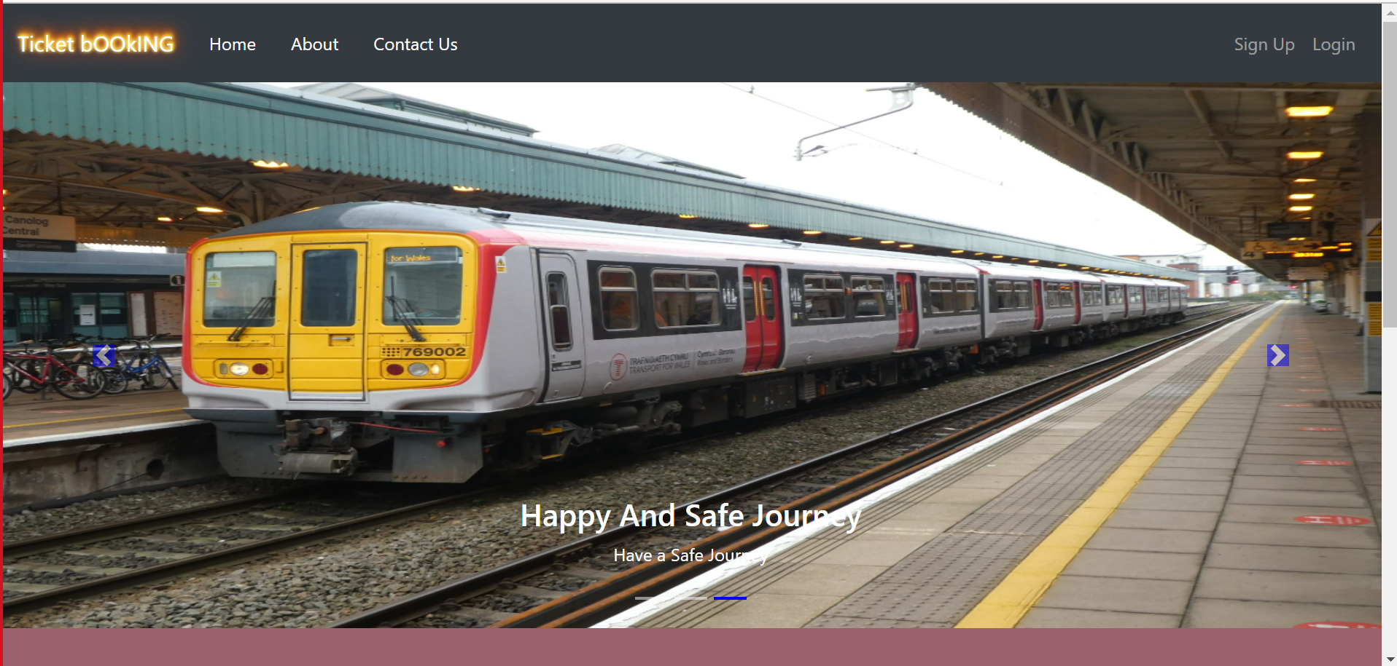
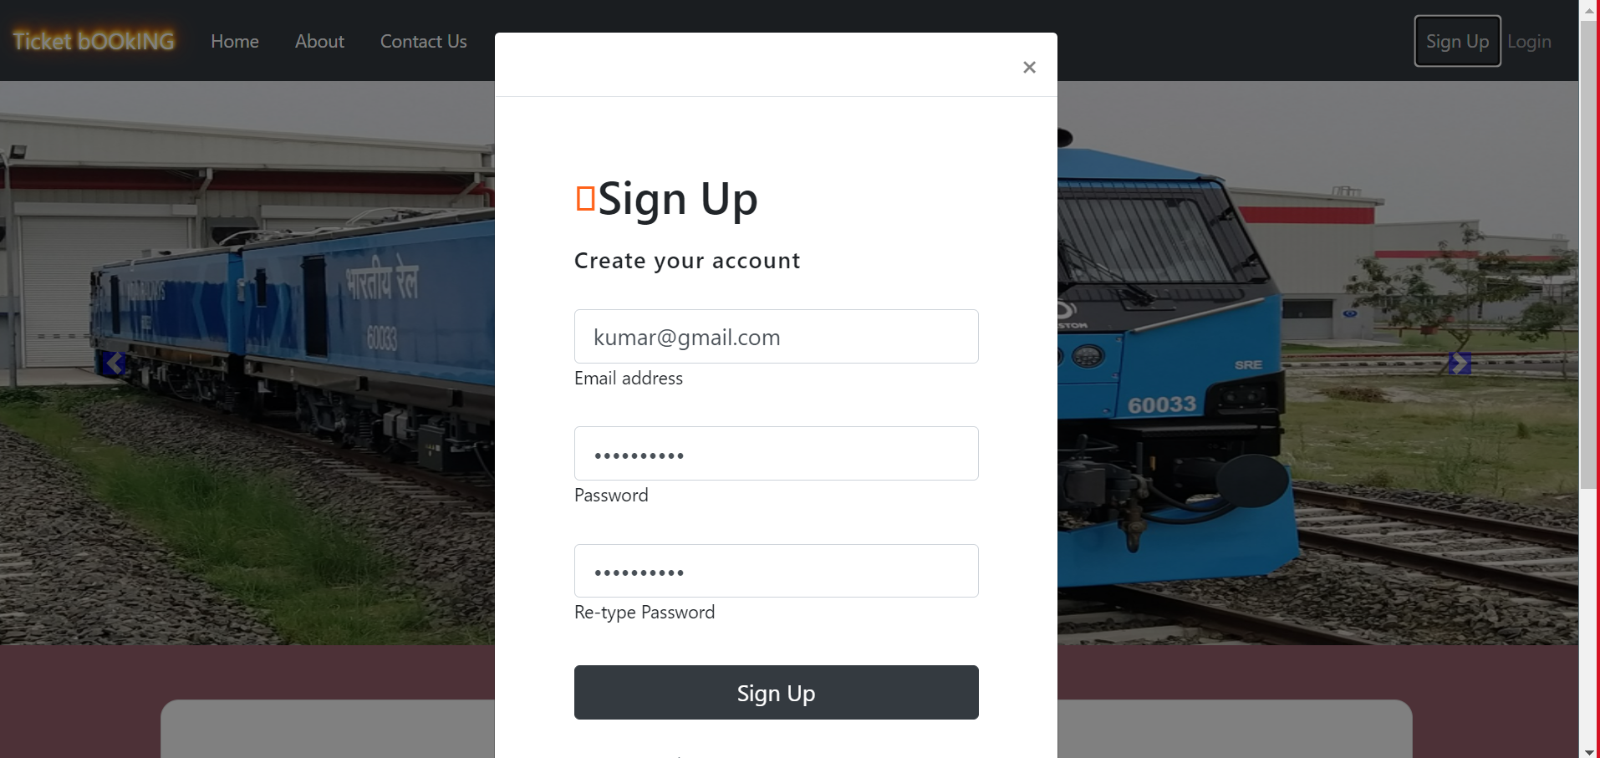
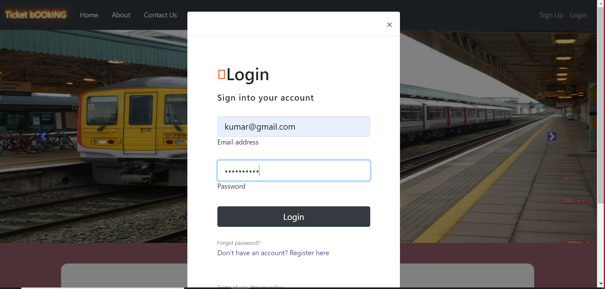
SCREEN SHOT
HOME PAGE
SIGN UP
LOGIN

Slide 7
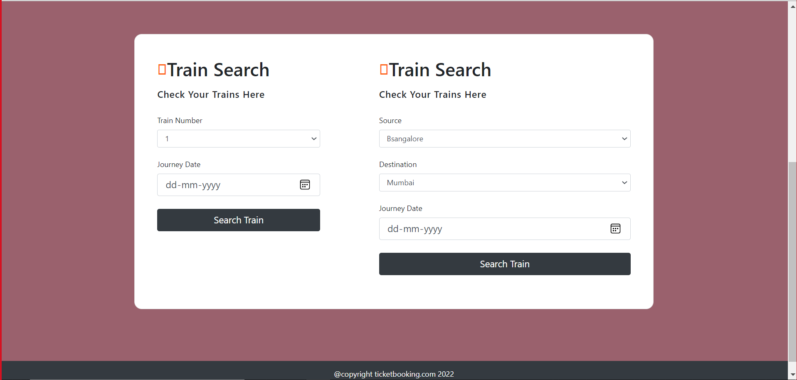
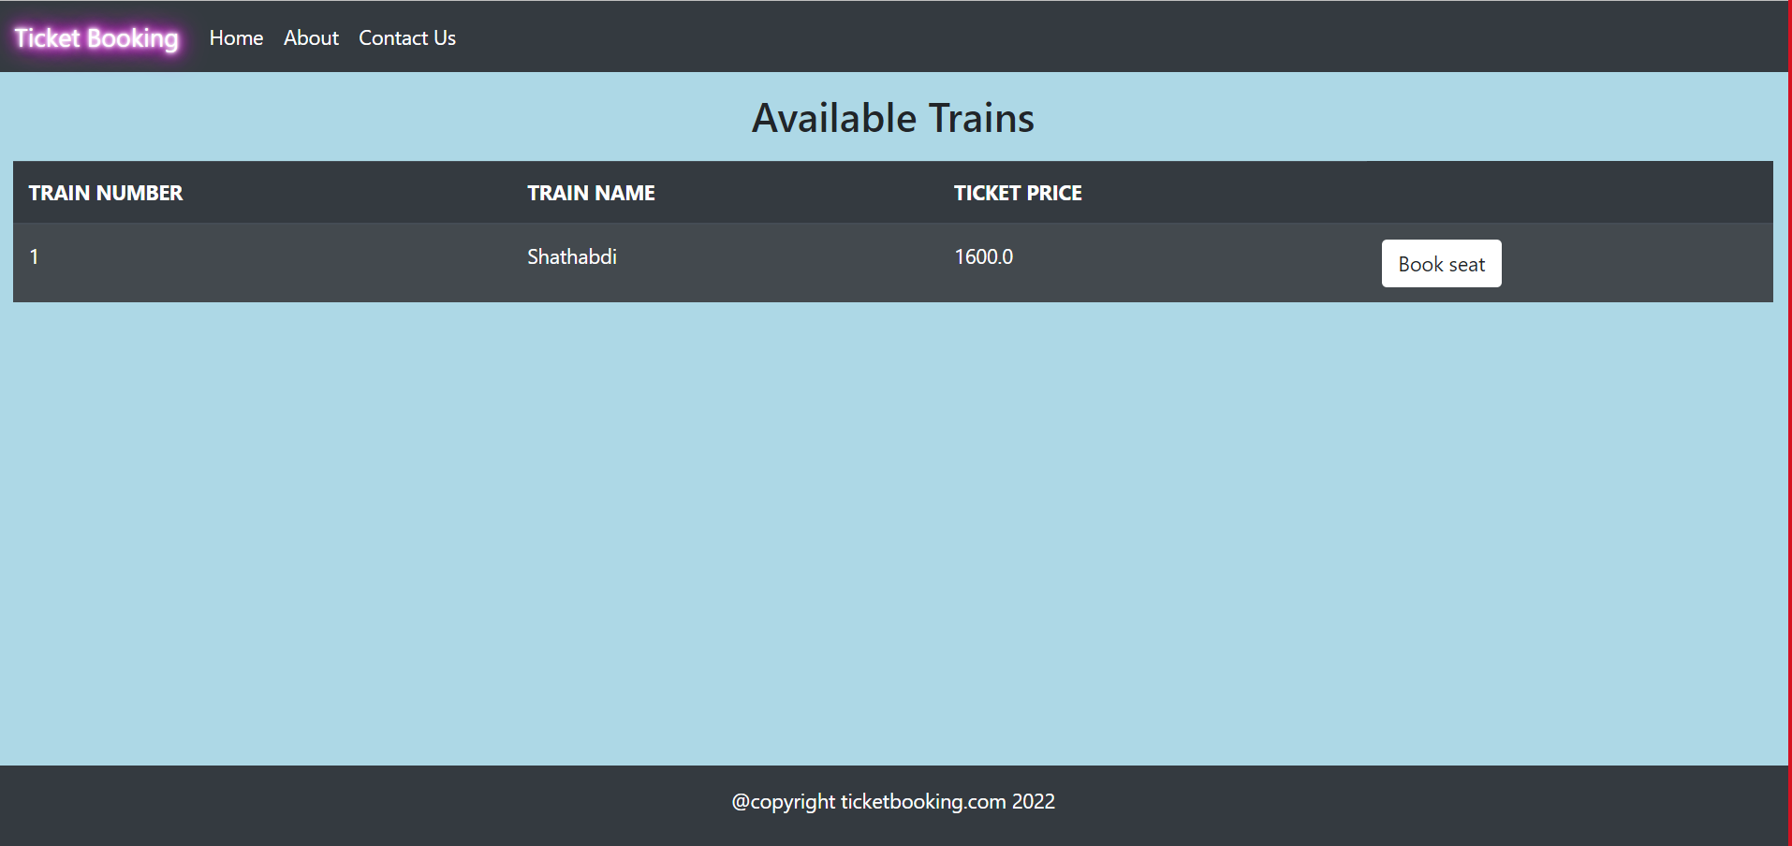

Slide 8
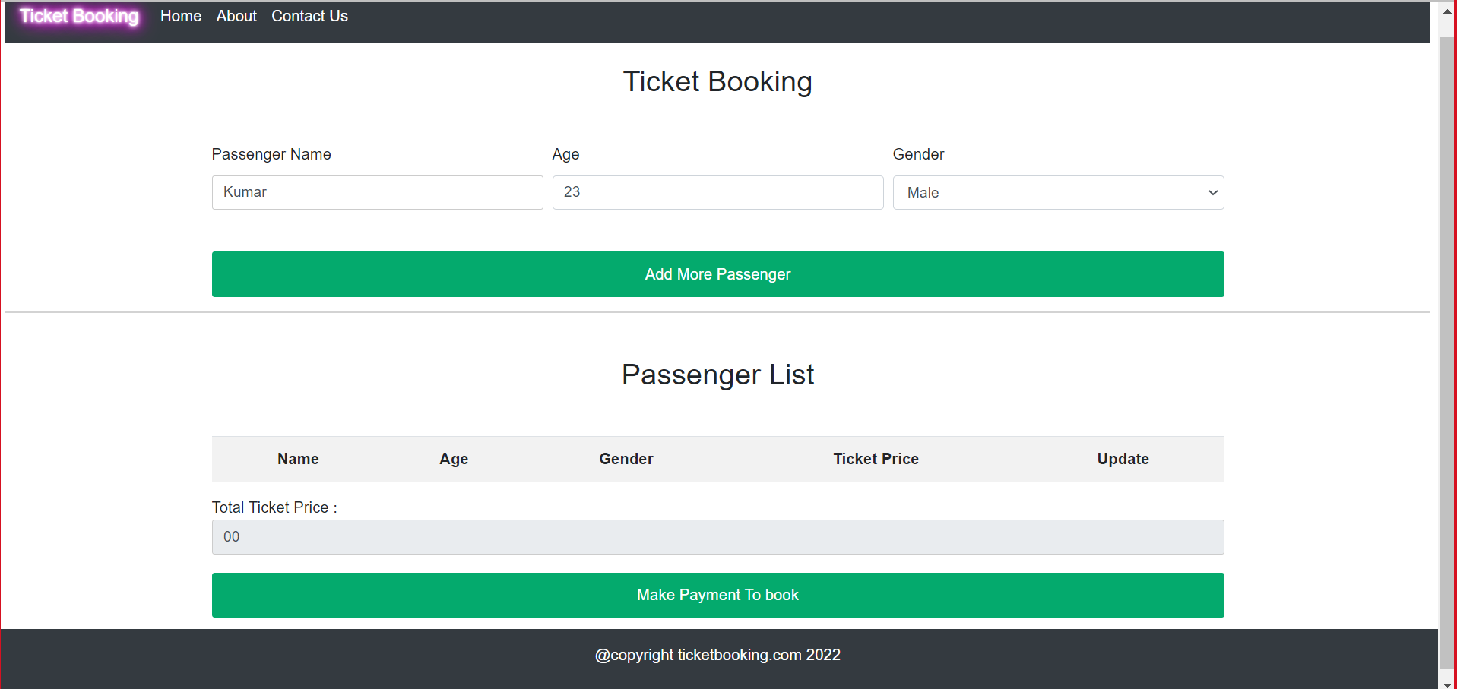
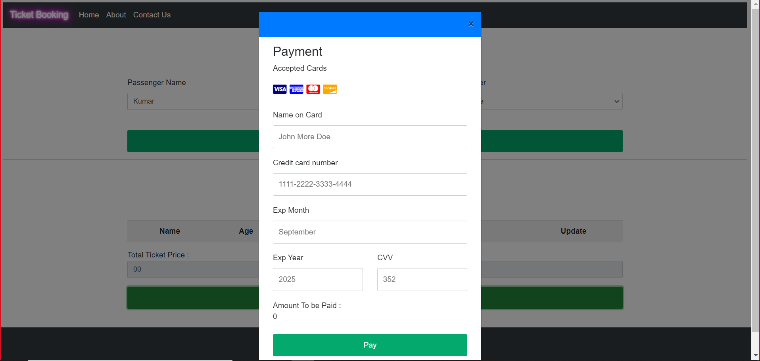

Slide 9
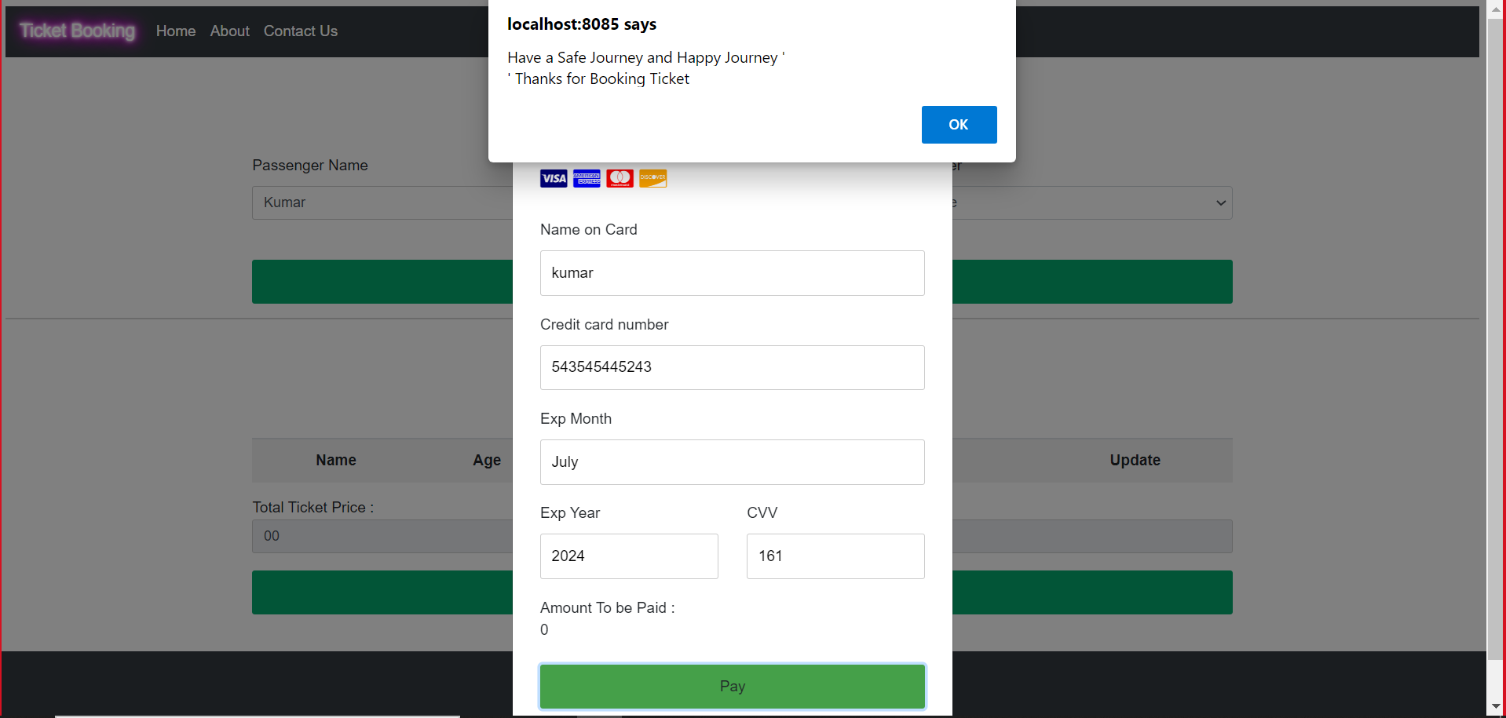
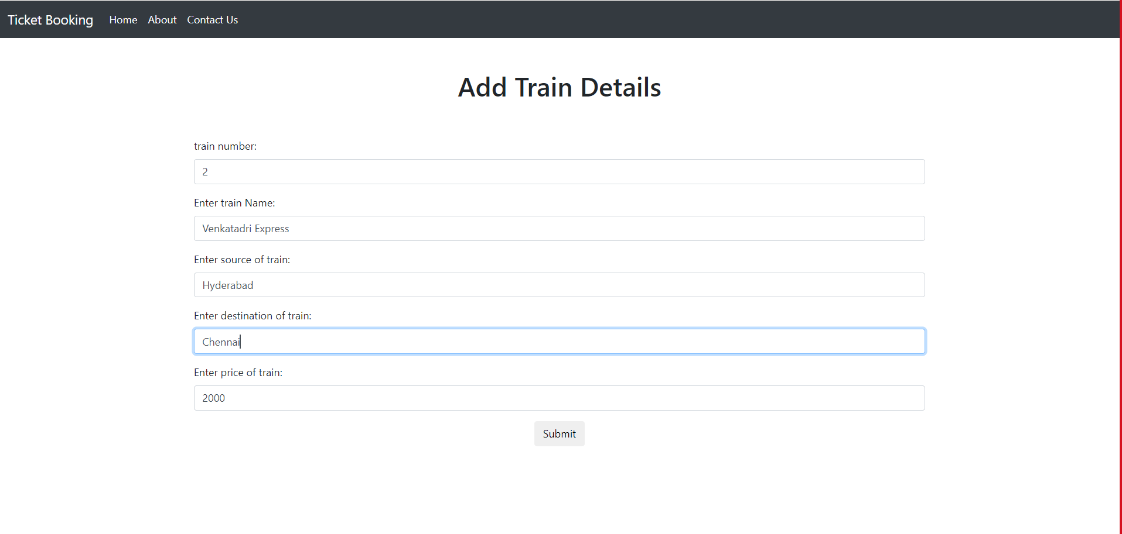

Slide 10
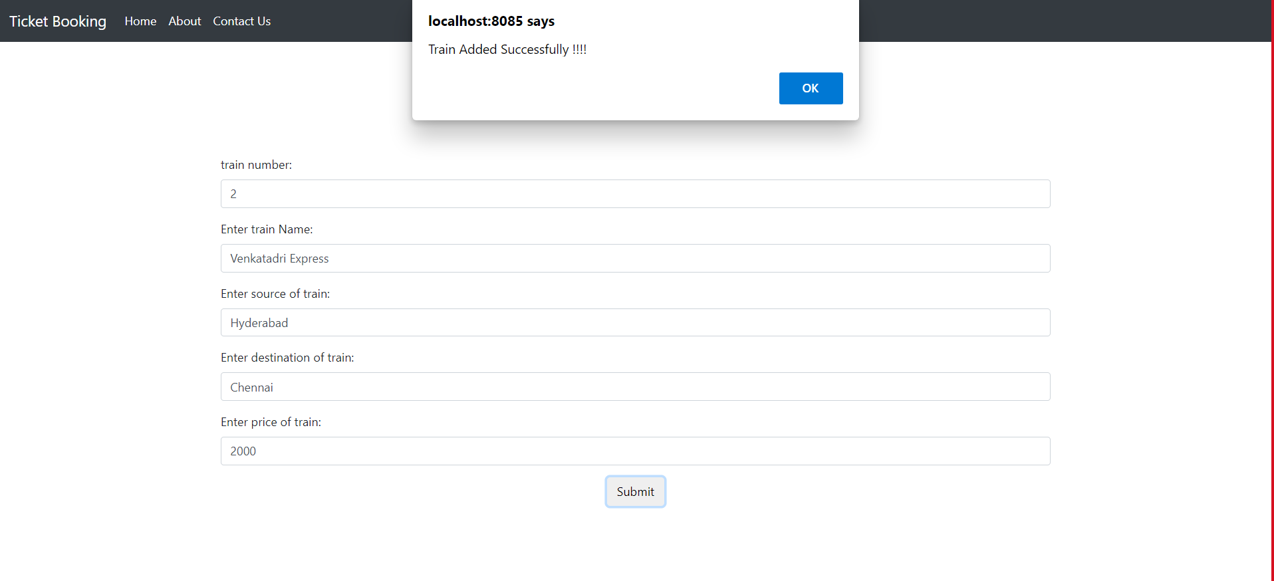

Slide 11


Slide 12


